Slide 1

WIPRO NGA Program – DWS B 2
Capstone Project Presentation –4th and 5th Sept
Project Title Here – MSI/EXE with Registry Add/ Delete/Move using PSADT
Presented by – SAUMYA SRIVASTAVA
www.rpsconsulting.in

Slide 2

Slide Title:- Why it need
Manual Installation of apps does not ensure registry entries are updated.
2. Without registry entries , IT cannot track or verify installations.
3. Updates/Uninstall may fail if old registry keys remain.
4. Need an automated way to install apps and manage registry changes consistently.
2025 - RPS Consulting all rights reserved

Slide 3
Slide Title:- About PSADT
Slide details:- PSAppDeployToolkit (PSADT) is a PowerShell-based framework.
Created to simplify software deployment in enterprises.
Provides ready-made functions for:
Installing MSI/EXE applications
Adding, deleting, or moving registry keys
Showing user-friendly prompts (Install / Defer)
Handling logs and errors automatically
Ensures deployments are consistent, reliable, and less error-prone.
Widely used in IT environments with ConfigMgr (SCCM), Intune, and automation scripts.
2025 - RPS Consulting all rights reserved

Slide 4
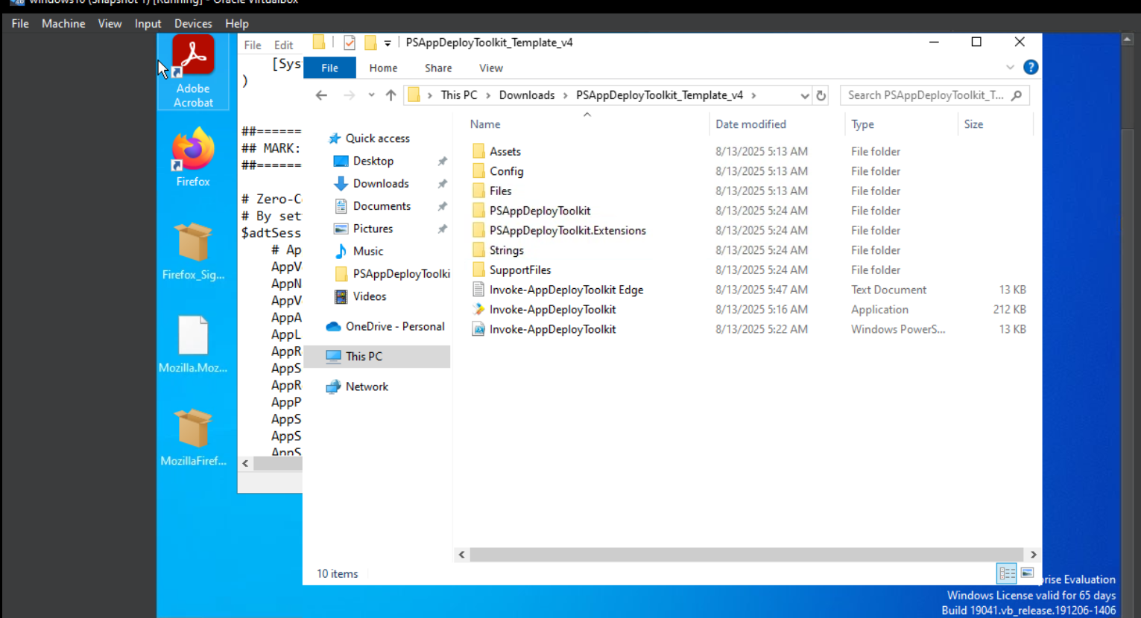
Slide Title:- PSADT app installation and extracting
Slide details here
2025 - RPS Consulting all rights reserved

Slide 5
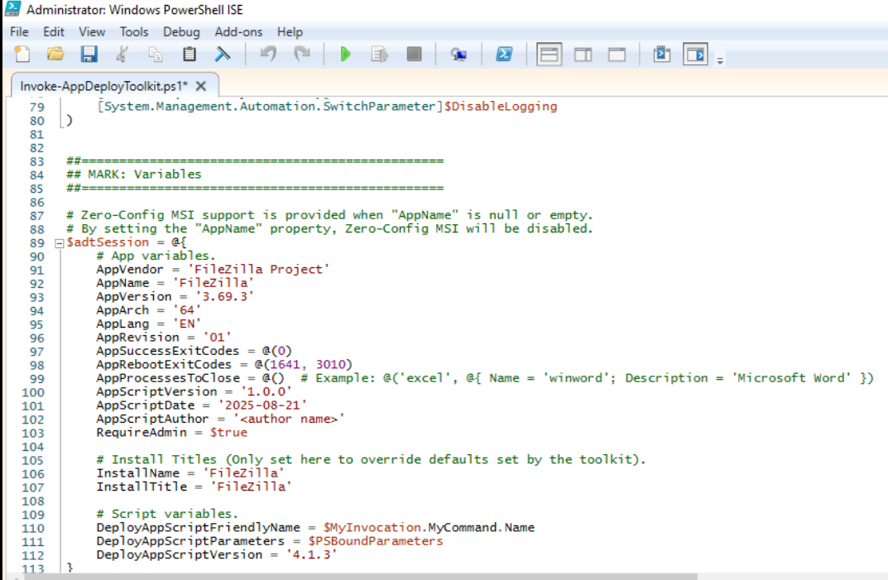
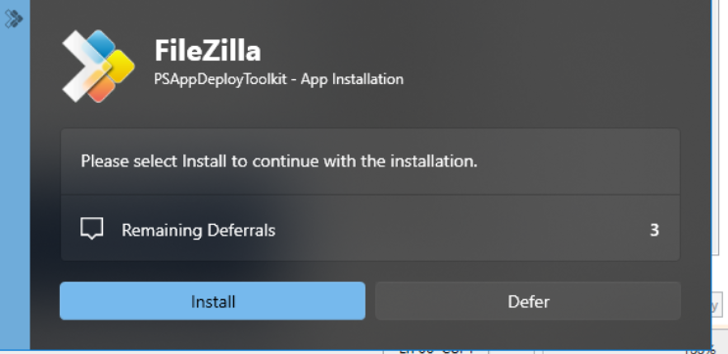
Slide Title:- Installing FileZilla using PSADT
Slide details here
2025 - RPS Consulting all rights reserved

Slide 6
Slide Title:- Registry
Registry = Central database of Windows OS
Stores system, user, and application settings
Structured in keys (folders) and values (data)
Example hives: HKLM, HKCU, HKCR, HKU, HKCC
Used by apps to check if installed, store configs, or enable/disable features
2025 - RPS Consulting all rights reserved

Slide 7
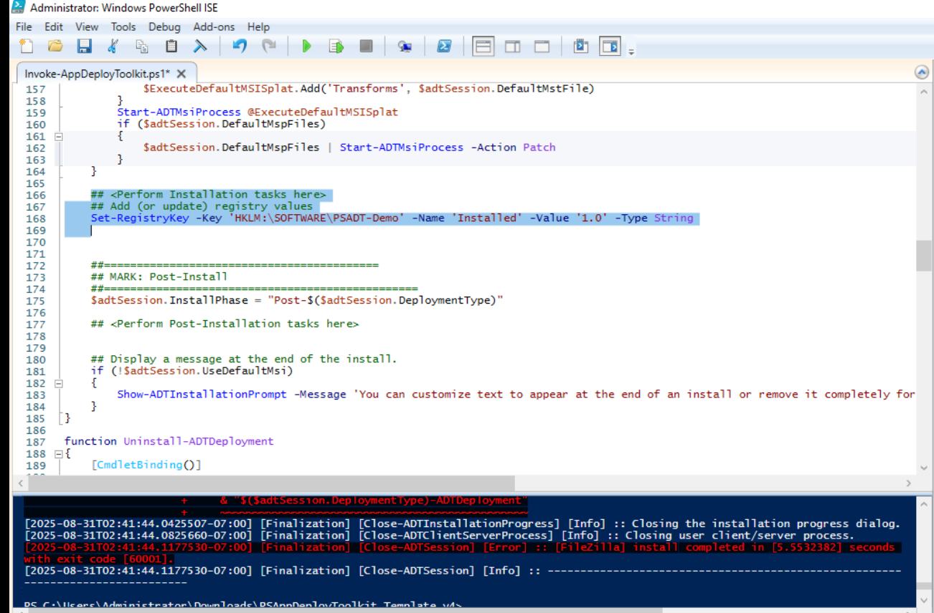
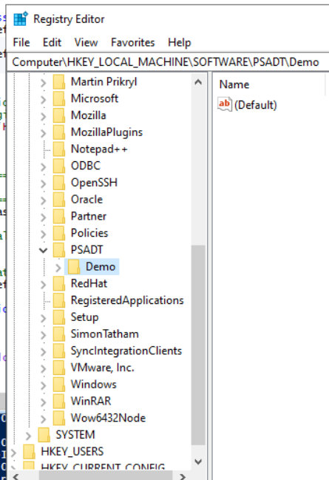
Slide Title:- Registry Add
Slide details here
2025 - RPS Consulting all rights reserved

Slide 8
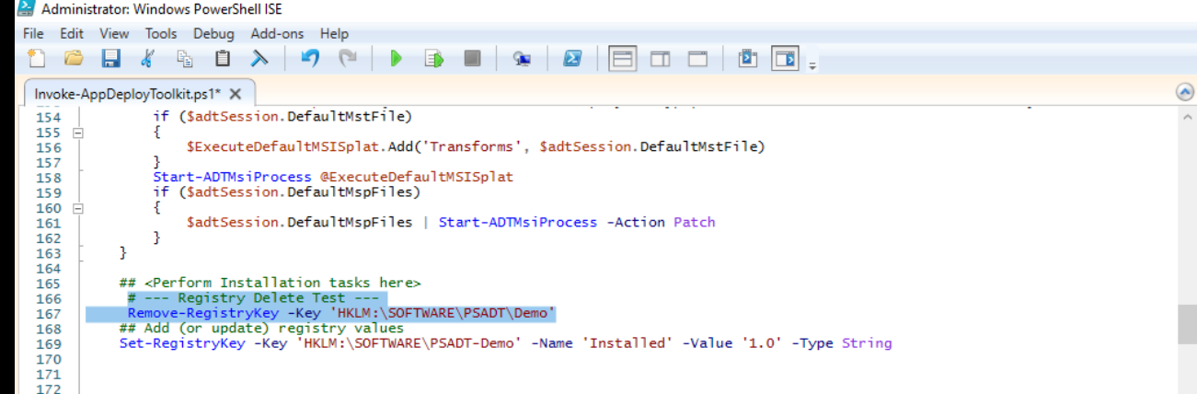
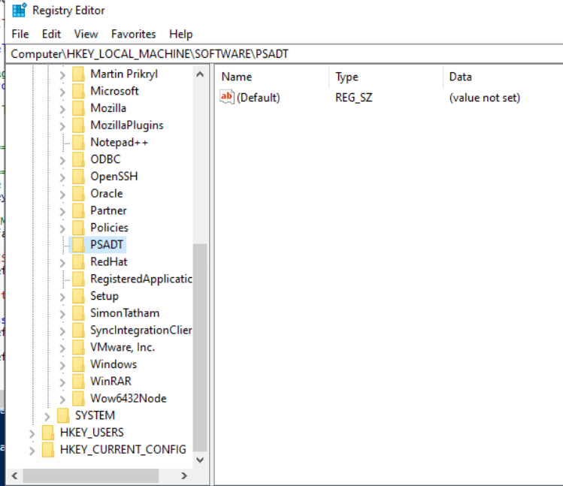
Slide Title:- Registry Delete
Slide details here
2025 - RPS Consulting all rights reserved

Slide 9
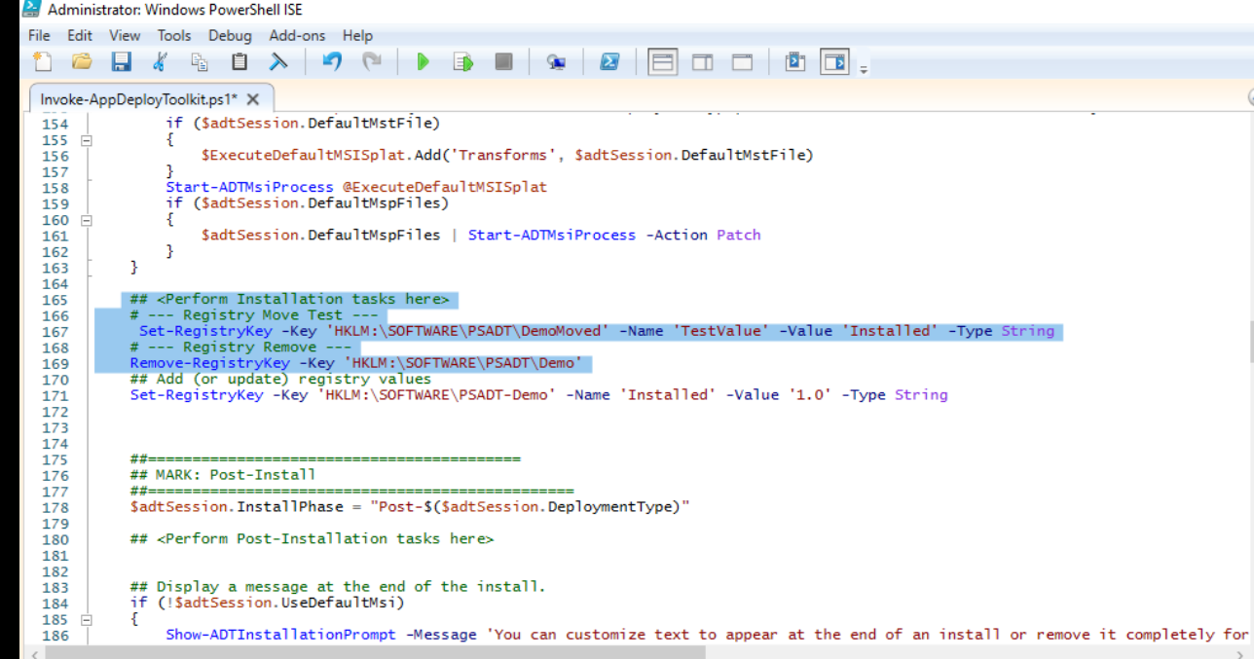
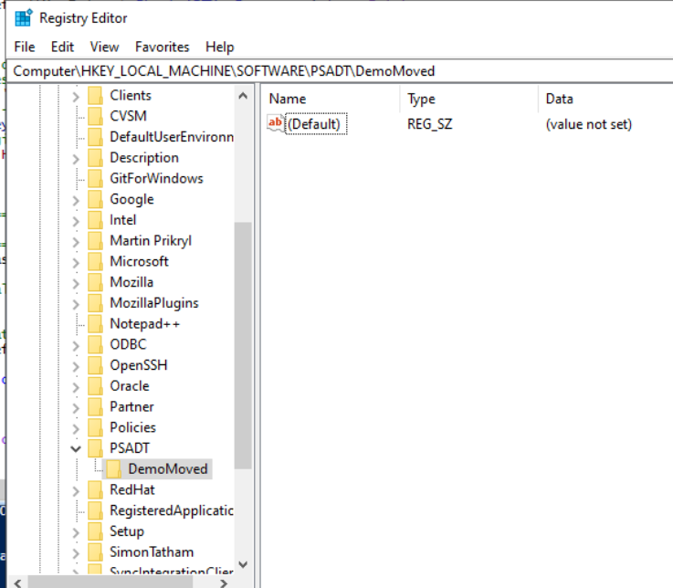
Slide Title:- Registry Move
Slide details here
2025 - RPS Consulting all rights reserved

Slide 10
Slide Title:- Conclusion
Windows Registry is a core database for system and application settings.
Managing registry entries is critical for software deployment and configuration.
PSAppDeployToolkit (PSADT) provides an automated, reliable way to install MSI/EXE and handle registry tasks (Add/Delete/Move).
This reduces manual errors, ensures consistency across systems, and makes it easier for IT to verify installation success.
Overall, using PSADT with registry operations improves efficiency, accuracy, and compliance in enterprise environments.
2025 - RPS Consulting all rights reserved

Slide 11
Slide Title
Thanks
2025 - RPS Consulting all rights reserved

